Slide 1


HUMAN ACTIVITY RECOGNITION USING CNN AND LSTM
GROUP-12

Slide 2


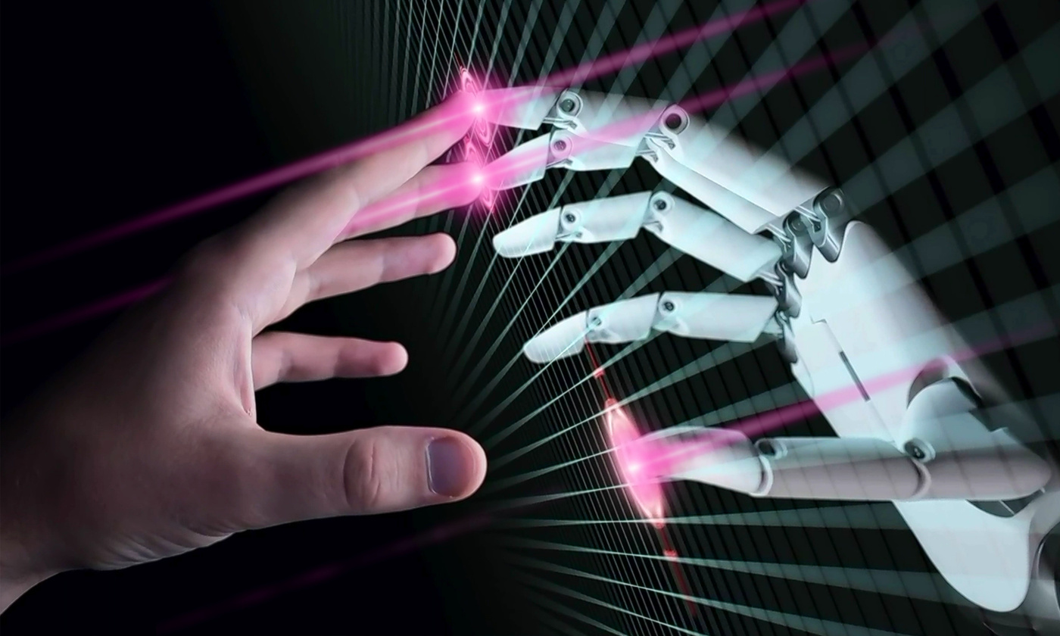
TEAM MEMEBERS
1. AADHIJITH - CB.SC.U4AIE24113
2. Kamalesh - CB.SC.U4AIE24121
3. Siva Adithya - CB.SC.U4AIE24124
4 . Siddharth Sanker - CB.SC.U4AIE24151

Slide 3
AGENDA
INTRODUCTION
OBJECTIVE
LITERATURE REVIEW
METHODOLOGY
FLOW CHART
IMPLEMENTATION
DISCUSSION
RESULT AND ANALYSIS
FUTURE WORKS
CONCLUSION

Slide 4

INTRODUCTION
Human Activity Recognition (HAR) involves detecting and classifying human actions from video data. It plays a key role in areas like surveillance, healthcare, and smart interfaces. Traditional models struggle with capturing both spatial and temporal features. This project uses a hybrid CNN-LSTM approach to effectively learn spatial patterns from video frames and temporal sequences across actions.

Slide 5
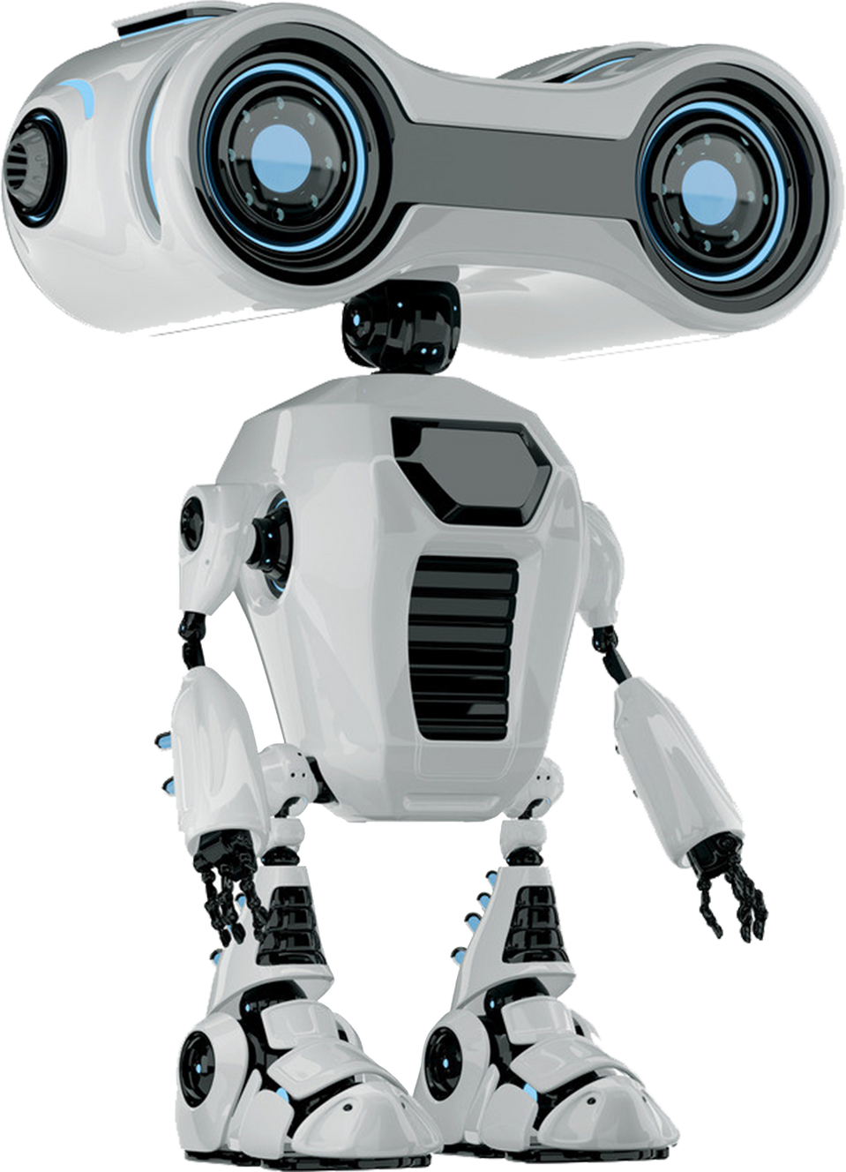

OBJECTIVE
To accurately recognize and classify human activities from video sequences using a hybrid CNN-LSTM architecture.
This system leverages spatial and temporal features for effective real-time activity monitoring.
It aims to enhance applications in surveillance, fitness tracking, and human-computer interaction

Slide 6
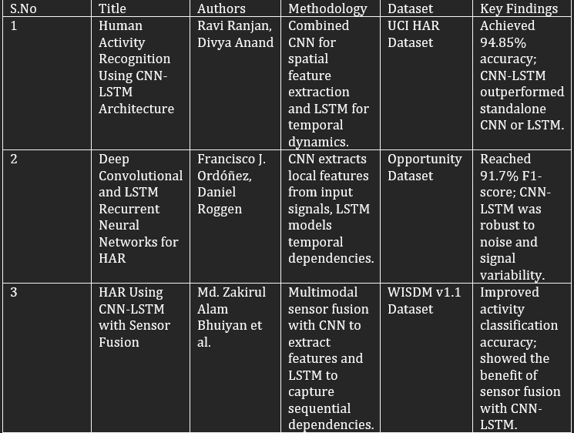
LITRATURE REVIEW

Slide 7
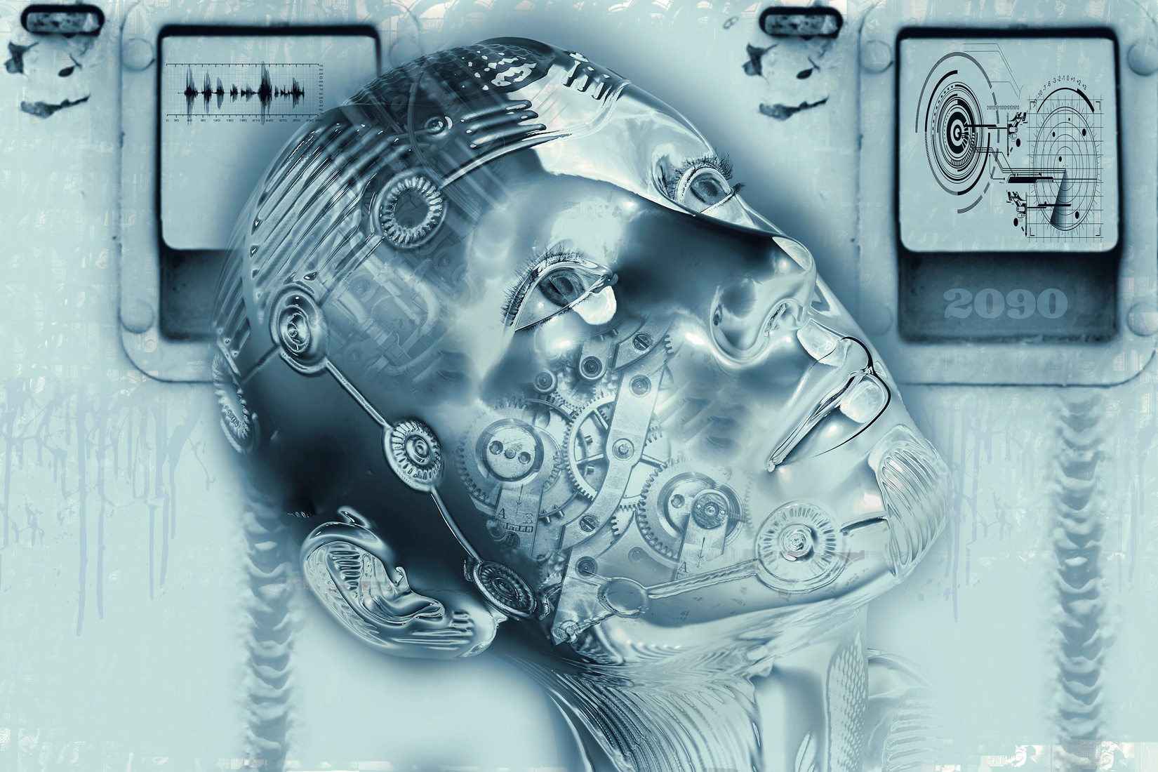
METHODOLOGY
Data Collection and Loading
The code utilizes the UCF50 dataset, a popular video dataset for human activity recognition.
Videos are read using cv2 (OpenCV), resized to a defined resolution, and processed as sequences of frames.
2.Data Preprocessing
Frames are resized to 64x64 for efficient processing.
Each video is split into 20-frame sequences to maintain temporal context.
Data augmentation may be included to improve model generalization.
3.Model Design
The model leverages a CNN-LSTM architecture:
CNN extracts spatial features from individual frames.
LSTM captures temporal dependencies across video frames.

Slide 8
The model layers include:
Conv2D layers for feature extraction.
MaxPooling2D for down-sampling.
LSTM layers for sequential data learning.
Dropout layers for regularization.
Dense layers for classification.
4.Training Strategy
A fixed seed (seed_constant = 27) ensures reproducibility.
The dataset is split into training and validation sets.
EarlyStopping is implemented to prevent overfitting.
5.Evaluation
The model's performance is measured using accuracy.

Slide 9
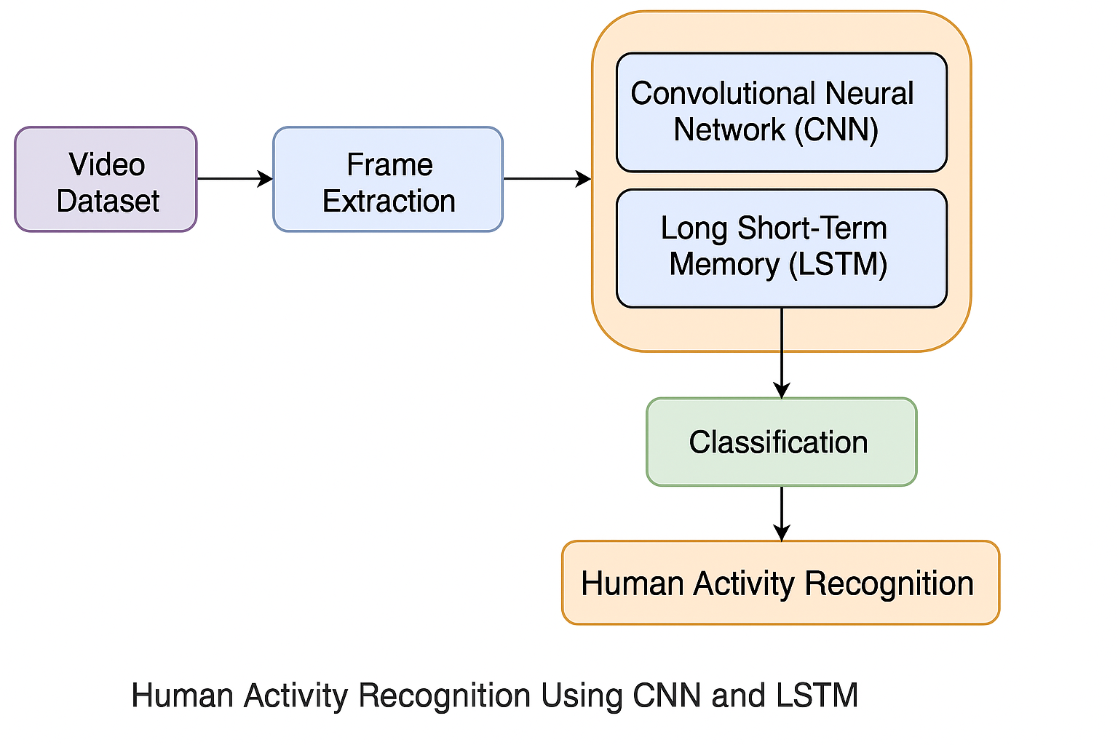
FLOW CHART

Slide 10
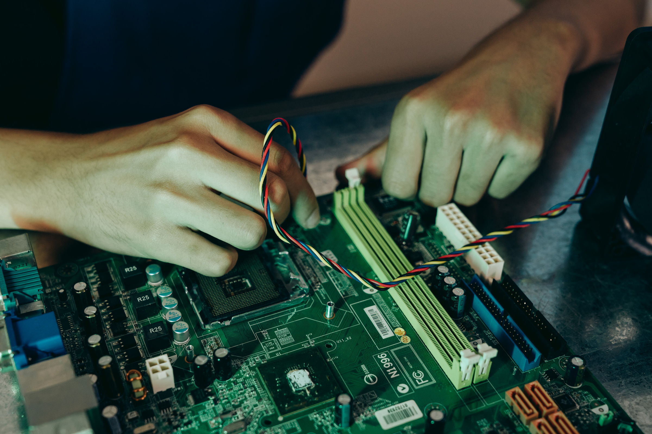
IMPLEMENTATION
TOOLS & PLATFORMS
– JUPYTER NOTEBOOK – FOR MODEL TRAINING, EXPERIMENTATION AND DEBUGGING
– KAGGLE API – TO DOWNLOAD THE UCI HAR DATASET
MAIN LIBRARIES
– TENSORFLOW & KERAS – FOR BUILDING AND TRAINING THE MODEL
– NUMPY & PANDAS – FOR DATA MANIPULATION
– MATPLOTLIB & SEABORN – FOR VISUALIZING RESULTS
– SCIKIT-LEARN – FOR EVALUATION METRICS

Slide 11

DISCUSSION
The training results clearly show that the model effectively learns to recognize human activities over time, achieving high accuracy on training data. However, the gap between training and validation accuracy indicates some overfitting, suggesting the model generalizes slightly less on unseen videos. The use of CNN for feature extraction and LSTM for temporal analysis proves to be a strong combination, as seen from the consistent improvement in training performance. With further optimization such as better regularization and more diverse data, the model’s validation performance can also improve, making it more robust for real-time and practical applications.

Slide 12
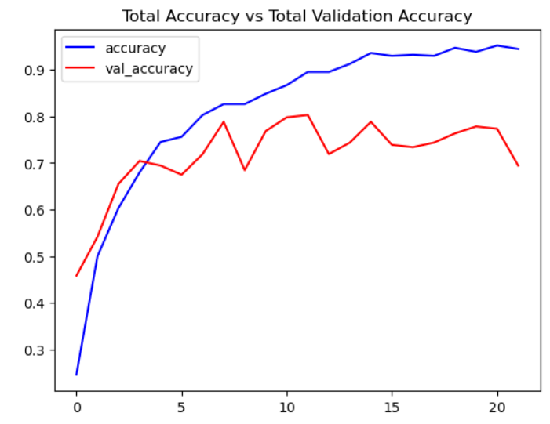
RESULT

Slide 13
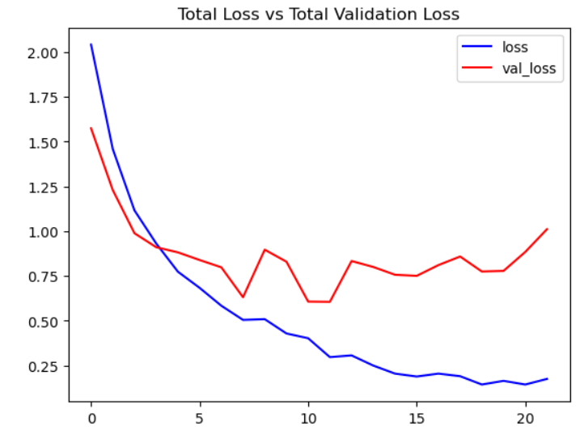
RESULT

Slide 14

ANALYSIS
Final Model Performance:
Validation Accuracy: 73.45%
Loss: 0.8304
Model Evaluation:
Successfully recognized various human activities with moderate accuracy and minimal overfitting.
The combined CNN-LSTM model efficiently captured spatial and temporal patterns in the dataset.

Slide 15
FUTURE WORKS
INCORPORATE REAL-TIME SENSOR DATA INPUT
EXPAND DATASET FOR BETTER GENERALIZATION
EMOTION AND GESTURE RECOGNITION INTEGRATION
Integrate live accelerometer and gyroscope data from wearable devices for on-the-go activity recognition.
Use larger and more diverse datasets to improve model accuracy across different environments and activity styles
Extend the system to recognize emotions and subtle gestures alongside basic activities for enhanced human-computer interaction

Slide 16
CONCLUSION
In this project, we implemented a hybrid CNN-LSTM model to recognize human activities from videos using the UCF50 dataset. The CNN effectively captured spatial features from each frame, while the LSTM modeled the temporal dynamics across frames. Our model achieved high training accuracy, validating the strength of this architecture for video-based activity recognition. The overall performance demonstrates the model's potential for real-world applications like surveillance and health monitoring. With further enhancements, such as real-time optimization and expanded datasets, the model can be made even more accurate and scalable.

Slide 17

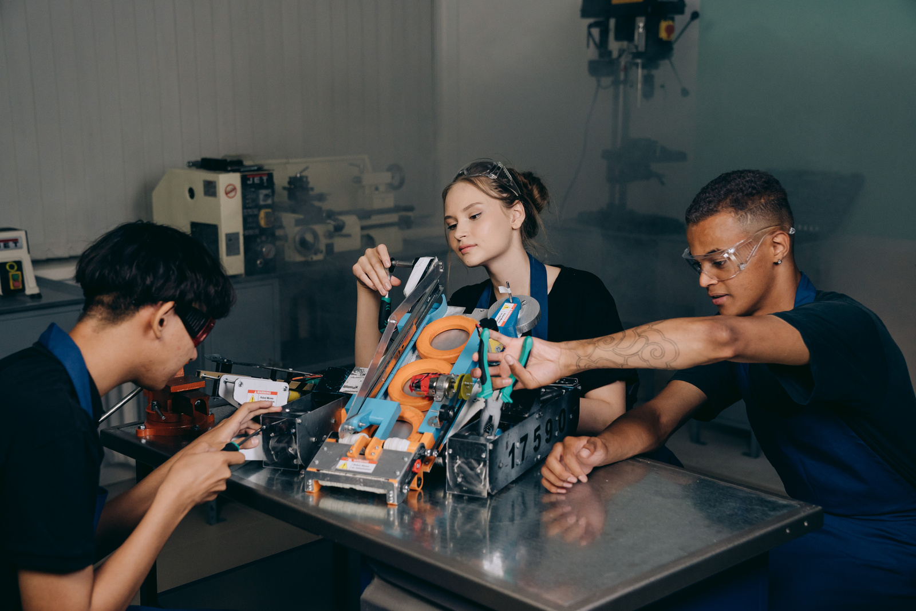
GROUP-12
THANK YOU

